Slide 1

Advanced Big Data: Real-Time Data Processing
Dan Zaratsian
AI & Machine Learning Engineer @ Google
d.zaratsian@gmail.com
https://github.com/zaratsian

Slide 2


TOPICS
Session 1: Intro Big Data Architectures and Services
Session 2: SQL and NoSQL
Session 3: Spark ML
Session 4: Spark ML & Scikit-learn Deployment
Session 5: Real-time Data Processing
Session 6: Cloud ML and Serverless

Slide 3



Email
Alerts
In-Stream
Data Processing
Events
(Data In)
Events
(Data Out)
Re-route to
Dashboard / 3rd Party Systems

Slide 4

Detect Events & Patterns of Interest
Filtering
Aggregation
Pattern Detection
Computation
Merging / Joins
Retention Window
Text Analytics
Clustering
Machine Learning
…more…
Events
(Data In)
Events
(Data Out)

Slide 5
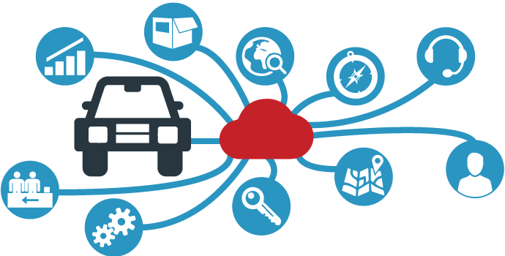

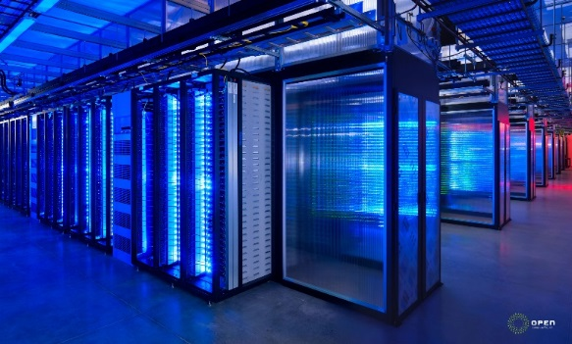
Streaming Analytics Ecosystem
Edge
Analytics
In-Motion
Analytics
At-Rest
Analytics
Connected Systems, Devices
Transactions, Logs, Clickstreams
Strategic Data Integration
Monitor equipment on
for failures and safety
issues, and take action.
Identify fraudulent
transactions and be
alerted in real-time.
Intelligently integrate customer
information with real-time
streaming data

Slide 6
Streaming Analytics: Types
Real-time Data Movement (Kafka, PubSub, etc)
Streaming Analytics (incremental, online, ESP)
Real-time Decisions (request & response) - Not quite streaming but can fit into real-time use case discussions.

Slide 7
Where are the Opportunities?
Competitive Pressure (Technology, Sensors, Analytics)
Risk & Compliance
Safety
Security
Personalization
* In many applications, the value of data has a shelf life

Slide 8
Batch Analytics
Logs
Clickstream
Social Media
Sensor Data
Call Center / Chat
Voice / Image / Video
Transactional
Documents
Database
Get Data
Reports & Dashboards
Adapters
FTP
APIs
Apache NiFi
Hive
BigQuery
Hbase
Cassandra
MongoDB
Historical Analysis

Slide 9
Streaming Analytics – Process Flow
Storm
Spark
Beam
Flink
SAS ESP
Logs
Clickstream
Social Media
Sensor Data
Call Center / Chat
Voice / Image / Video
Transactional
Documents
Alerts
Database
Get Data
Real-time Analytics
Reports & Dashboards
Adapters
FTP
APIs
Apache NiFi
Hive
BigQuery
Hbase
Cassandra
MongoDB
Historical Analysis

Slide 10
Streaming Analytics – Process Flow
Kafka
RabbitMQ
PubSub
Kinesis
Storm
Spark
Beam
Flink
SAS ESP
Logs
Clickstream
Social Media
Sensor Data
Call Center / Chat
Voice / Image / Video
Transactional
Documents
Alerts
Bus
Database
Get Data
Real-time Analytics
Reports & Dashboards
Adapters
FTP
APIs
Apache NiFi
Hive
BigQuery
Hbase
Cassandra
MongoDB
Historical Analysis

Slide 11
Streaming Analytics – Process Flow
Kafka
RabbitMQ
PubSub
Kinesis
Storm
Spark
Beam
Flink
SAS ESP
Logs
Clickstream
Social Media
Sensor Data
Call Center / Chat
Voice / Image / Video
Transactional
Documents
Bus
Alerts
Bus
Database
Get Data
Real-time Analytics
Reports & Dashboards
Adapters
FTP
APIs
Apache NiFi
Hive
BigQuery
Hbase
Cassandra
MongoDB
Historical Analysis

Slide 12
Streaming Analytics – Process Flow
Internal Service (trigger offer)
3rd Party Service
Kafka
RabbitMQ
PubSub
Kinesis
Storm
Spark
Beam
Flink
SAS ESP
Logs
Clickstream
Social Media
Sensor Data
Call Center / Chat
Voice / Image / Video
Transactional
Documents
Bus
Bus
Alerts
Database
Get Data
Real-time Analytics
Reports & Dashboards
Adapters
FTP
APIs
Apache NiFi
Hive
BigQuery
Hbase
Cassandra
MongoDB
Historical Analysis

Slide 13

Developed in the NSA (code name NiagaraFiles)
Open-sourced in 2014 (NSA team left and started Onyara, which was acquired by Hortonworks).
Control, automate, and audit the bi-directional flow of data between software systems.

Slide 14
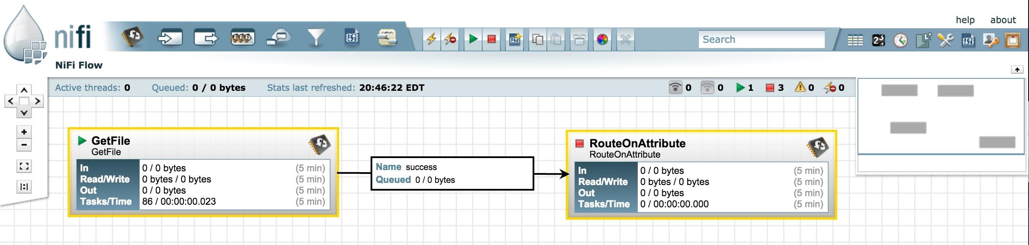
Drag and drop processors to build a flow
Start, stop, and configure components in real time
View errors and corresponding error messages
View statistics and health of data flow
Create templates of common processor & connections

Slide 15
Kafka

Slide 16

Developed by Linkedin
“Apache Kafka is used for building real-time data pipelines and streaming apps. It is horizontally scalable, fault-tolerant, wicked fast...” -- https://kafka.apache.org/
Up to 2 million writes/sec on 3 cheap machines (in 2014)
https://engineering.linkedin.com/kafka/benchmarking-apache-kafka-2-million-writes-second-three-cheap-machines

Slide 17
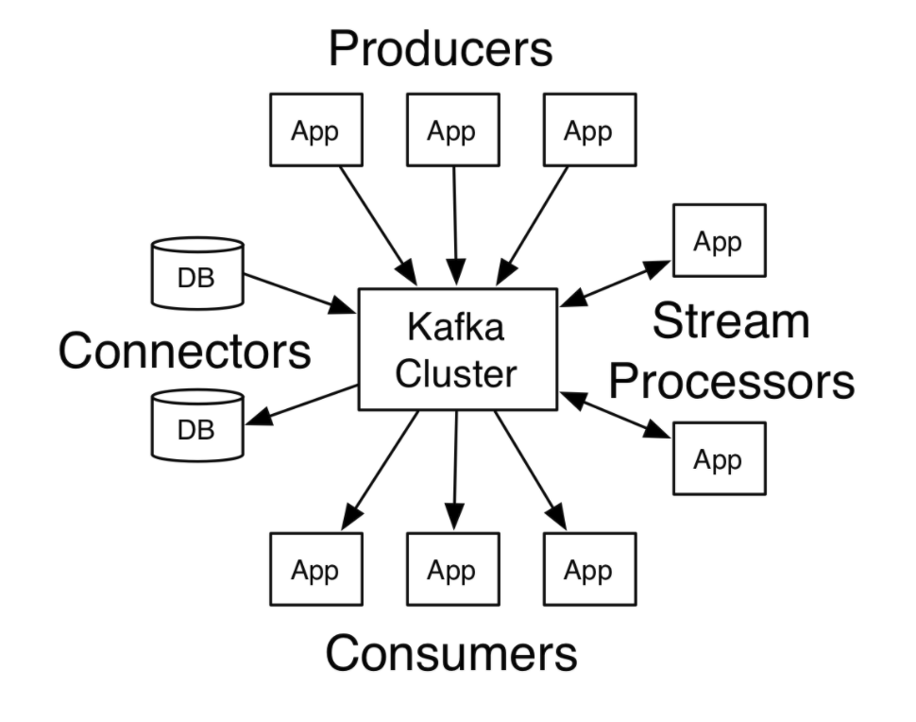

Slide 18
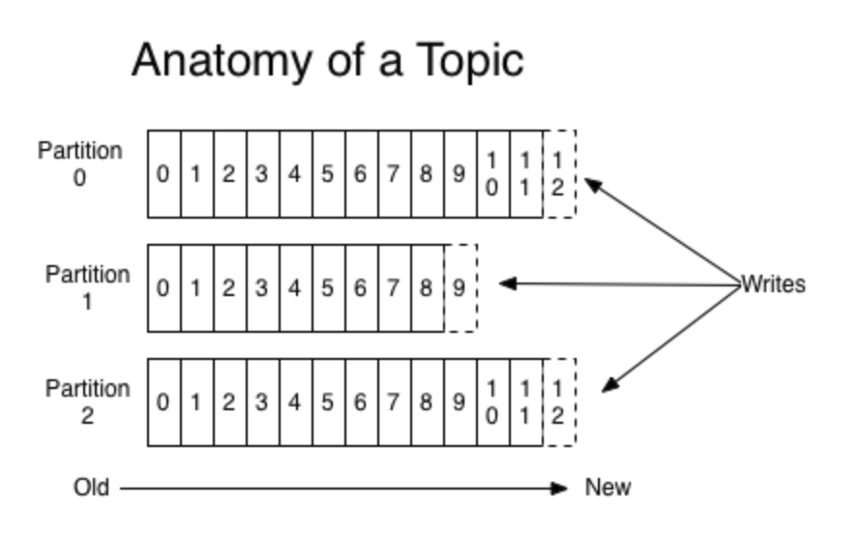
Kafka Topic - Category or feed name to which records are published.
Topics in Kafka are always multi-subscriber; that is, a topic can have zero, one, or many consumers that subscribe to the data written to it.
Producer (Publisher) - Publishes data to a topic
Consumer (Subscriber) - Receives data from a Topic either through pull or push methods.

Slide 19
producer
consumer
producer
Kafka Cluster
consumer
producer
consumer

Slide 20
PubSub

Slide 21
Pub/Sub is like email for machines
Without Pub/Sub
With Pub/Sub
Without Pub/Sub, computer systems must be online at the same time to get anything done. If one is unavailable, there is no business. It’s the world of telephones.
With Pub/Sub, like with email, no one has to be online at the same time. Pub/Sub delivers messages instantly if everyone is online and safely holds them until they can be delivered otherwise.

Slide 22
How does Pub/Sub simplify systems?
Pub/Sub

Slide 23
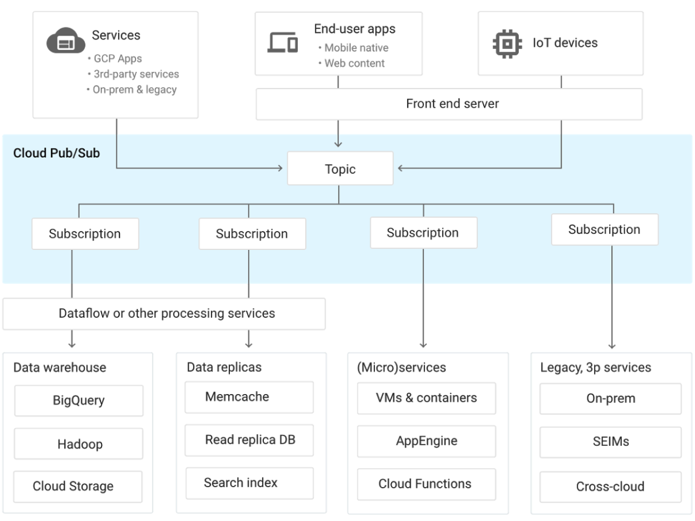
High-Level Architecture - PubSub as the Central Service

Slide 24
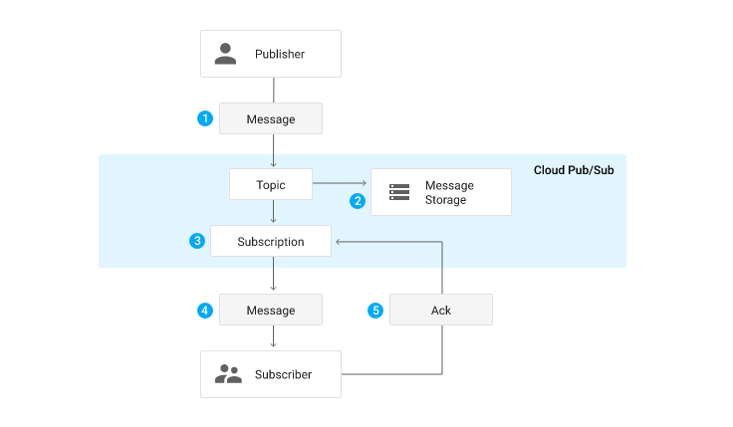
PubSub Architecture - Flow of Events

Slide 25
Spark Streaming

Slide 26

Spark Streaming
Spark Streaming is an extension of the core Spark API that enables scalable, high-throughput, fault-tolerant stream processing of live data streams.
DStream API (powered by RDDs)
Micro batch
Fault tolerance Checkpointing
Structured Streaming
Structured Streaming is a scalable and fault-tolerant stream processing engine built on the Spark SQL engine.
Uses Spark Dataframes
No batch concept
Fault tolerance Checkpointing
Built on Spark SQL library

Slide 27
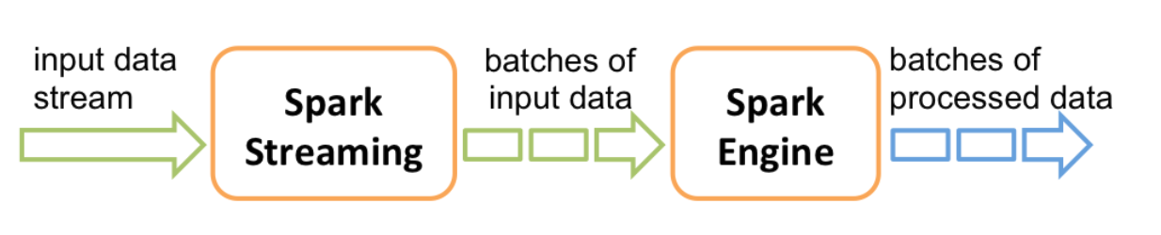
Spark Streaming Architecture

Slide 28
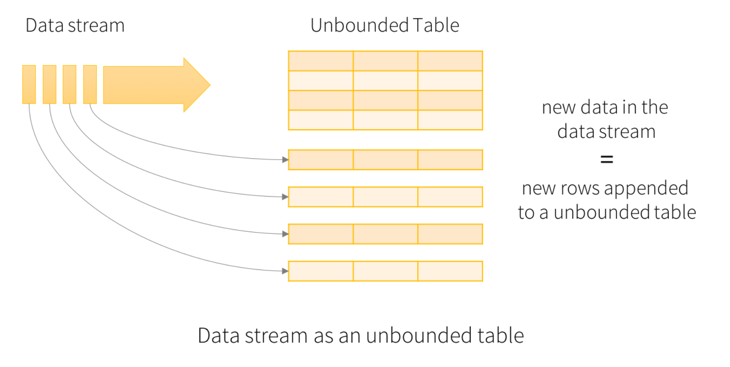
Structured Streaming Architecture

Slide 29
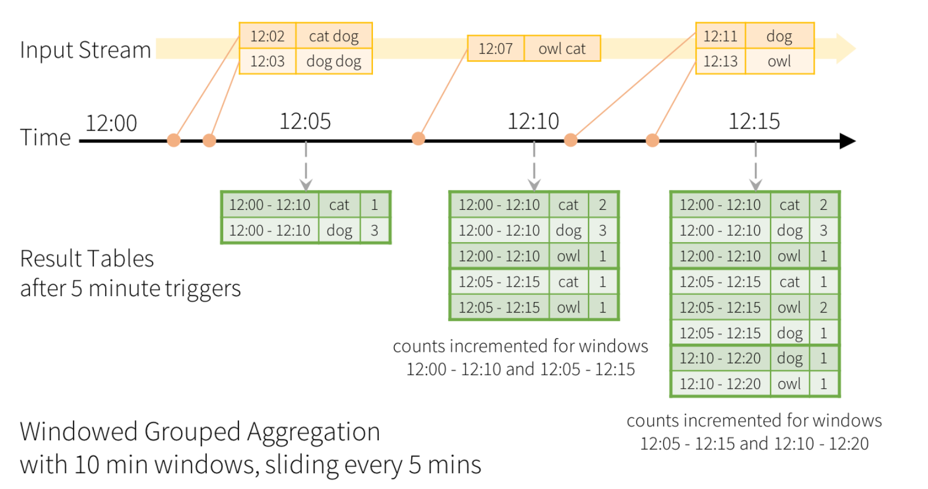

Slide 30
Structured Streaming Concepts
Sources (Input)
Sinks (Output)
Modes
Complete - entire results table will be output
Append - append events added since last trigger
Update - update events added since last trigger
Operations
Basic Operations (aggregation, filtering, etc)
Window Operations
Join Operations
Triggers - Specifies fixed batch interval or as a continuous processing
Streaming Dedup
Fault tolerance - Structured Streaming can ensure end-to-end exactly-once semantics under any failure. (checkpointing and write-ahead-logs)

Slide 31
Apache Beam

Slide 32

Apache Beam 101
Apache Beam is an open source, unified model for defining both batch and streaming data-parallel processing pipelines.
SDKs
Backends (Runners)
Python
Java
Scala
Go
Google Dataflow
Spark
Apex
Samza
Flink
Others...

Slide 33
Apache Beam Terminology
Pipeline Contains all of the data and steps in your data processing task
PCollection Data, it is a distributed, multi-element data set
Transforms The operations in your pipeline to process data
Windowing Divides a PCollection based on the timestamps of event(s)
Triggers Determines when to emit the aggregated results of each window
Runner The software that accepts a pipeline and executes it
Watermarks The system's notion for when all data has arrived in a window

Slide 34
Apache Beam Terminology
Pipeline Contains all of the data and steps in your data processing task
PCollection Data, it is a distributed, multi-element data set
Transforms The operations in your pipeline to process data
Windowing Divides a PCollection based on the timestamps of event(s)
Triggers Determines when to emit the aggregated results of each window
Runner The software that accepts a pipeline and executes it
Watermarks The system's notion for when all data has arrived in a window
Types of Transforms:
ParDo (custom transform, similar to a “map”)
GroupByKey
CoGroupByKey
Combine
Flatten
Partition

Slide 35
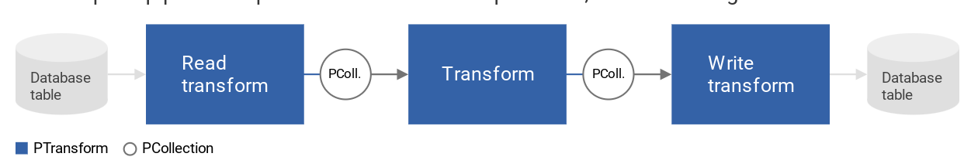
Apache Beam Pipelines

Slide 36
Tweets
Auto-Complete Example
{#argentina scores!, watching #armenia vs #argentina, my #art project, …}
Read
ExtractTags
{argentina, armenia, argentina, art, ...}
Count
{argentina->5M, armenia->2M, art->90M, ...}
ExpandPrefixes
{a->(argentina, 5M), a->(armenia, 2M), …, ar->(argentina, 5M), ar->(armenia, 2M), ...}
Top(3)
{a->[apple, art, argentina], ar->[art, argentina, armenia],...}
Write
Predictions
Notes:
Know beginning and ending.
Read batch of tweets. At bottom are the models, to remind us where we’re heading. Fill in the middle.
Only care about #tags, so extract them and throw away the rest.
Need ranking. Count # unique #tags.
Prefix model. Explode all prefixes.
Almost there, but too many results. We only need 3, so let’s take the top 3.
Now we’re there. Left - write it somewhere our app can read it.
Next: Now we’ve laid out the steps as a list of abstract data transforms. What does it take to go from this to actual code?

Slide 37
Tweets
Pipeline p = Pipeline.create();
p.begin()
Read
.apply(TextIO.Read.from(“gs://…”))
ExtractTags
.apply(ParDo.of(new ExtractTags()))
Count
.apply(Count.create())
ExpandPrefixes
.apply(ParDo.of(new ExpandPrefixes())
Top(3)
.apply(Top.largestPerKey(3))
Write
.apply(TextIO.Write.to(“gs://…”));
Predictions
p.run();
Notes:
Very little!
Code maps directly onto abstract data transformation.
Most of my time was spent in the design phase. When that was done, coding was fast.
Point out ParDo. User-defined function. Par because parallel on all records. Mapper function. Usually short
<ANIMATION>
All that’s needed to expand prefixes.
Next:
have your code, can run locally and test on sample data. But now you want to run this on your actual big data.

Slide 38
Apache Beam Windowing
Fixed
Sliding
Sessions
1
2
3
4
1
2
3
1
3
4
Key 1
Key 2
Key 3
4
5
2
Windowing divides data into time-based finite chunks
Often required when doing aggregations over unbounded data

Slide 39
Apache Beam Windowing
Fixed-time windows
Python
from apache_beam import window
fixed_windowed_items = (
items | 'window' >> beam.WindowInto(window.FixedWindows(60)))
Sliding time windows
Python
from apache_beam import window
sliding_windowed_items = (
items | 'window' >> beam.WindowInto(window.SlidingWindows(30, 5)))
Session windows
Python
from apache_beam import window
session_windowed_items = (
items | 'window' >> beam.WindowInto(window.Sessions(10 * 60)))

Slide 40
Google Cloud Dataflow 101

Slide 41

Google Cloud Dataflow
Dataflow is a fully managed streaming analytics service that minimizes latency, processing time, and cost through autoscaling and batch processing.
Serverless
Unified Batch & Stream Processing
Open Source - Apache Beam
Windowing, Exactly-once processing, SDKs

Slide 42


Google Cloud Dataflow - Service Architecture
Resource Management
SOURCE
SINK
Graph Optimization
Compute and Storage
Intelligent Watermarking
Work Scheduler
Auto-Healing
Unbounded
Resource Auto-scaler
Monitoring
Dynamic Work Rebalancer
Log Collection
Bounded

Slide 43













Google Cloud Dataflow - Reference Architecture
Events, metrics, and so on
Cloud Pub/Sub
BigQuery
Cloud Datalab
Stream
Cloud Dataflow
Cloud Machine Learning
Raw logs, files, assets, Google Analytics data, and so on
Visualization
and BI
Cloud Storage
Bigtable
Batch
Co-workers
Cloud Dataproc
Batch
B
A
C
Spanner
Applications
and Reports

Slide 44
Tweets
Pipeline p = Pipeline.create();
p.begin()
Read
.apply(TextIO.Read.from(“gs://…”))
ExtractTags
.apply(ParDo.of(new ExtractTags()))
Count
.apply(Count.create())
ExpandPrefixes
.apply(ParDo.of(new ExpandPrefixes())
Top(3)
.apply(Top.largestPerKey(3))
Write
.apply(TextIO.Write.to(“gs://…”));
Predictions
p.run();
Notes:
Very little!
Code maps directly onto abstract data transformation.
Most of my time was spent in the design phase. When that was done, coding was fast.
Point out ParDo. User-defined function. Par because parallel on all records. Mapper function. Usually short
<ANIMATION>
All that’s needed to expand prefixes.
Next:
have your code, can run locally and test on sample data. But now you want to run this on your actual big data.

Slide 45
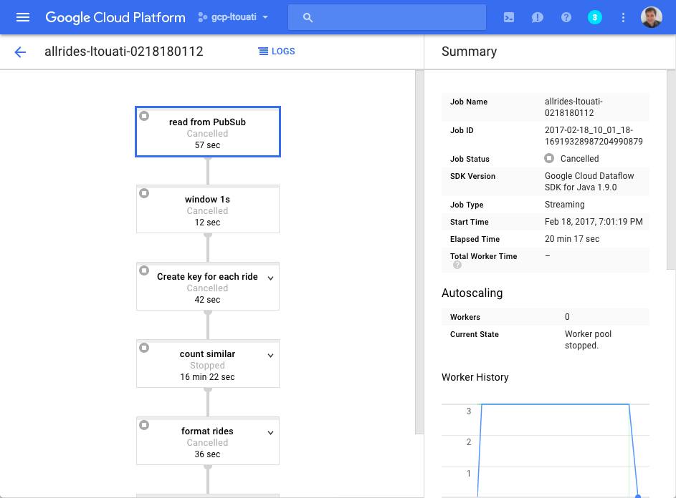
Pipeline p = Pipeline.create();
p.begin()
.apply(TextIO.Read.from(“gs://…”))
.apply(ParDo.of(new ExtractTags())
.apply(Count.create())
.apply(ParDo.of(new ExpandPrefixes())
.apply(Top.largestPerKey(3))
.apply(TextIO.Write.to(“gs://…”));
p.run();
Google Cloud Dataflow

Slide 46
Creating a Dataflow Pipeline
Use pre-built Dataflow Templates
Write custom Apache Beam code (Java, Python, Scala, Go)
Use Google Dataflow SQL (in Alpha)
Hybrid of any of the above methods

Slide 47
Advanced Big Data: Real-time Data Processing
Thanks!
Dan Zaratsian
Cloud Engineer @ Google
Machine Learning Solutions

